Slide 1
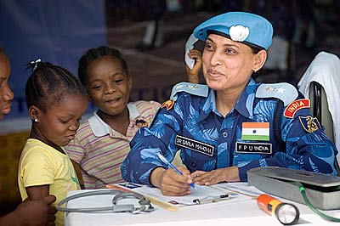
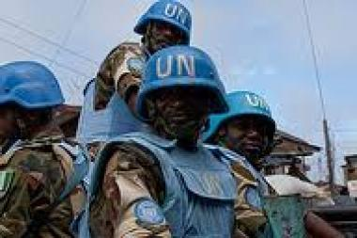
Contemporary Challenges to Peacekeeping Operations in Africa
Colonel (Dr) Emmanuel Kotia
Visiting Professor, Kennesaw State University (USA)

Slide 2
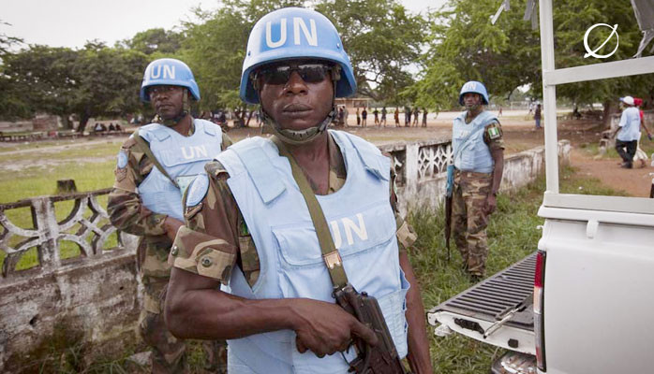
Introduction

Slide 3
Aims and Objectives
Discuss some initial thoughts of the characteristic of peacekeeping operations
Outline in brief some of the types of peace operations conducted or authorized by the UN in Africa
Assess the structural challenges of peace operations in Africa in relation to economic, political, gender, protection of civilians and capacity challenges
Draw some conclusions

Slide 4
What is Peacekeeping
Peacekeeping is a technique designed to preserve the peace, however fragile, where fighting has been halted, and to assist in implementing agreements achieved by the peacemakers.
Over the years, peacekeeping has evolved from a primarily military model of observing ceasefires and the separation of forces after inter-state wars, to incorporate a complex model of many elements – military, police and civilian – working together to help lay the foundations for sustainable peace
(UN Capstone Doctrine: 18)

Slide 5
Some Thoughts on Peacekeeping….
General usage of Peacekeeping “refers to any international effort involving an operational component to promote termination of armed conflict or resolution of longstanding disputes” (Diehl 1993:4)
UN use of the term ‘peacekeeping’ refers generally to such international efforts, sometimes differentiated from term of ‘peace support operations’
To avoid confusion with limited meaning of term as applied to ‘peacekeeping’
Use of UN ‘peace operations’. Brahimi Panel suggests both may be interchangeable

Slide 6
Traditional Peacekeeping Operations
These operations are intended to support peacemaking between states by creating the political space necessary for the belligerent states to negotiate a political settlement.
Traditional peacekeeping takes place in the space between a ceasefire agreement and the conclusion of a political settlement
Traditional peacekeepers do not propose or enforce particular solutions; rather, they work with the consent of the belligerents and try to build confidence in order to facilitate political dialogue

Slide 7
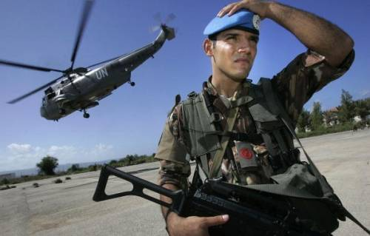
Multi-Dimensional Peacekeeping
Multi-dimensional UN peacekeeping operations are peacekeeping operations comprising a mix of military, police and civilian components working together to lay the foundations of a sustainable peace
Capstone Doctrine:97

Slide 8
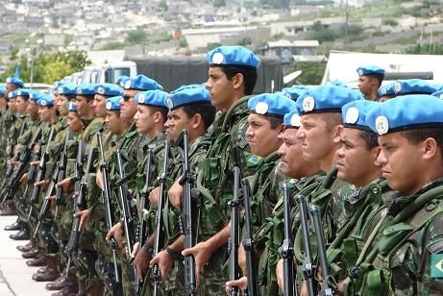
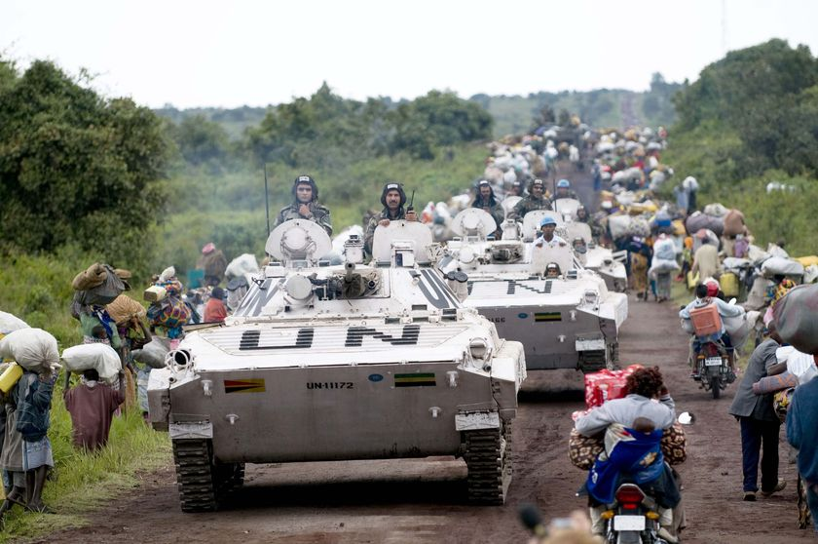
Wider Peacekeeping
These operations are intended to fulfill the aims of the traditional peacekeeping as well as certain additional tasks on the context of ongoing conflict – delivery of humanitarian relief
Wider peacekeeping operations developed an ad hoc response to the breakdown of ceasefire or political agreements that enabled the original deployment of a traditional or assisting transition operation

Slide 9
Peace Enforcement Operations
These operations aim to impose the will of the UNSC upon the parties to a particular conflict (UN Charter Chapter VII)
Peace Enforcement operations are the closest manifestation of the collective security role originally envisaged for the UN by the authors of its Charter
Challenges:
Lack of clarity of the use of enforcement – use of all means available
UN cannot conduct large scale operations – funding, equipment
Discriminatory usage – Liberia conflict was ignored in 1990, Rwanda genocide

Slide 10
Transitional Authority
These are also multi-dimensional operations deployed after a peace agreement, but they distinguished by their assumption of sovereign authority over a particular territory
Transitional Authorities have the following tasks:
  Protection of civilians
  Peace enforcement
  Make and enforce laws
  Exercise control over all aspects of state’s economy
  Preside over territory’s borders
  Regulate the media
  Manage property law
  Run schools, hospitals, sanitation system, electricity grid, roads
  Administer judicial system

Slide 11
Peace Support Operations
These are designed to help establish post Westphalian peace – Blair’s doctrine (1999)
They aim to establish liberal democracy political systems and societies within states
They combine robust military forces capable of limited peace enforcement tasks if a ceasefire breaks down – Bosnia, Kosovo, DRC
It has a strong civilian component that includes civil administration, humanitarian agencies; and police and justice officers – Liberia, Cambodia
Peace Support Operations attempt the impartial enforcement of political settlement

Slide 12
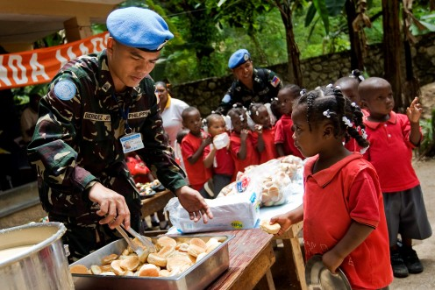
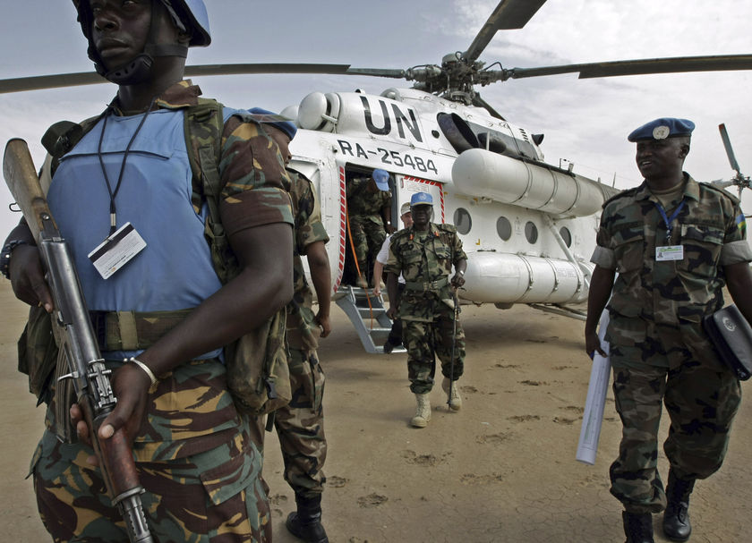
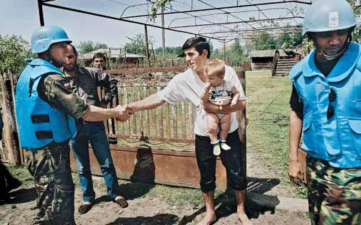

Peace Support Operations in Liberia

Slide 13
Modern Peacekeeping: Characteristics
Vast majority of internal armed conflicts: internecine, fratricidal
Non-state actors, proliferation of factions
Lack of clearly defined (no) frontlines
Cross-border involvement of state and non-state actors (borderless conflicts)/Proliferation of small arms
Affinity with natural resources
Impunity
State collapse, destruction, failure, decay…
Insufficient consent, Partial ceasefires
Lack of faith with comprehensive agreements

Slide 14
Peacekeeping Theory: A Broad Outline
Main idea to ‘keep the peace’ (by managing conflict dynamics within a dynamic international system), maintaining fragile ceasefires, stabilizing proxy conflict, preventing another world war (nuclear)
Silence of UN Charter on specific provisions raised political ambiguity
This called for functional adaptation, consistent with UN purpose and principles in a milieu of evolving realities of international system
Chap VII collective security ‘enforcement’ powers undermined by P5 veto powers
Charter lacunae:
  Chap VI: Pacific Settlement of Disputes
  Chap VII: Coercive measures (Enforcement/Peace Enforcement)
  Chap VIII: Regional Arrangements.
Silence on a specific legal provision for (armed) conflict in the grey area: Chap 6.5
Peacekeeping
Peace Enforcement
Chap VI
No provision of Peacekeeping, Peace enforcement
Chap VII
Consent
No Consent
UN Force
Regional Organization

Slide 15
Peacekeeping Theory: A Broad Outline
A catalyst or dynamic for multi-track development of differentiated intervention:
Chap VI: an adaptive doctrine of military operations to ‘keep the peace’ founded on acceptable principles to Supper Powers (consensus and non enforcement)
Chap VII: an adaptive doctrine of military operations to ‘enforce the peace’ founded on the use of lead nations and regional organizations (coalitions)
Chap VI and a half: a middle ground adaptive doctrine of military operations to ‘keep the peace’ founded on acceptable le principles to Super Powers (consensus and non enforcement), but employing robust measures
PEACEKEEPING
(MULTI-DIRECTIONAL)
CHAPTER VI
‘PEACEKEEPING ‘
(CONSENT BASED)
CHAPTER VI AND A HALF ROBUST PEACEKEEPING
(CONSENT BASED)
CHAPTER VIII
‘PEACE ENFORCEMENT ‘
(NON CONSENT BASED)

Slide 16
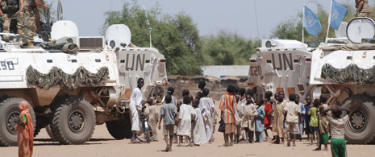

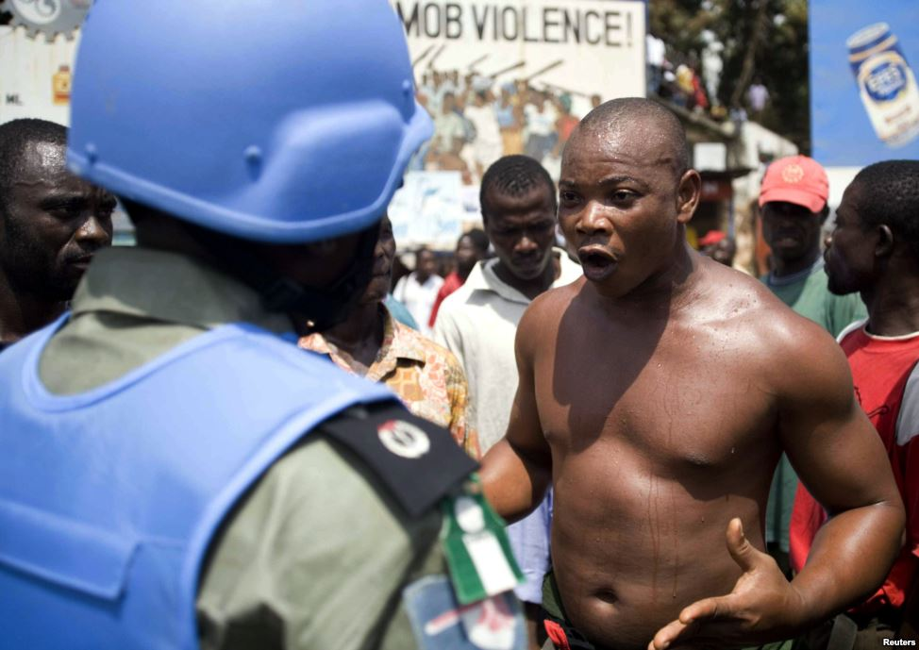
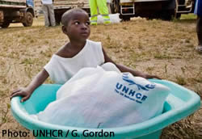
Structural Challenges of Peacekeeping Operations in Africa

Slide 17
Economic Challenges of Peace Operations in Africa
Disparities of wealth among potential partners
Africa partners are poor as compare to European and other regions in providing financial contributions for peacekeeping
Non payment of dues by African countries to the African Union and peacekeeping contributions
The Africa Union Peace Fund had less than $70 million between 1993 and 2005 - $45 million was provided by non African actors
Peace fund had negative balance by 2009

Slide 18
Lack of Technical Capacity for Peace Operations
Africa Peace Operations Lack the Following:
Well-trained troops, police and civilian personnel
Good leaders – Head of Missions, Force Commanders
Appropriate materials and equipment – APCs, Helicopters, Strategic airlift capabilities
Well equipped hospital facilities
Logistic Bases and Hubs
Training facilities
Management structures and qualified staff to sustain peacekeeping missions

Slide 19
Political Challenges to Peace Operations
Lack of consensus in partnership between the Africa Union and the UN in peace operations
Regular clash of philosophies, priorities, and practical approaches between the two councils
UN peacekeeping doctrine makes the Africa Union unable to deploy a peace mission
UN PK Doctrine: peacekeeping is unlikely to succeed where one or more of the following conditions are not in place:
1) a peace to keep, where the signing of a ceasefire or peace agreement is one (but not the only) important indicator that parties are genuinely seeking peace;
2) positive regional engagement;
3) full backing of a united Security Council; and
4) a clear and achievable mandate with resources to match (Paul Williams)

Slide 20
Political Challenges to Peace Operations
The AU argues that the UN’s peacekeeping doctrine renders it unable to ‘deploy a peace mission in a situation like Somalia even though significant advances have been made on the ground
The AU has developed a different peacekeeping doctrine; instead of waiting for a peace to keep, the AU views peacekeeping as an opportunity to establish peace before keeping it
Africa Union Concerns
Undesirable trend that appears to be selective on the part of the UN Security Council and that seems to disregard full consideration of the position and/or recommendations of the AU or its organs
The practice that the United Nations can only engage where there is peace to keep translates into the United Nations abandonment of some of the most challenging crisis situations in Africa
The notion that the UN can only engage in a crisis when there is a peace to keep is unacceptable to Africa

Slide 21
Introduction of Privatization of Peace Operations
Use of private organization for peace operations is not compatible to the responsibility of the UN for the maintenance of International peace and security
Private contractors have a mixed track record of accountability and transparency – Blackwater in Iraq
Private contractors have profit driving motive in their activities
Private companies sometimes abandon contracts and flee theatre of operations when things get tough – Gurkha Security Guards left Sierra Leone operations
Private contractors both contribute to and reflect the growing erosion of state monopoly on the legitimate instruments of military force

Slide 22
Protection of Civilians Challenge
Protection of Civilians (PoC) is a core function of contemporary peacekeeping operations
Platform for PoC are: sexual violence against women, violence against IDPs and refugee camps, limited access, targeting of humanitarian staff, impunity – local capacity for rule of law, participate in political negotiations, prosecution of individuals
Lack of coordination between actors and humanitarian agencies
  Scope of humanitarian agencies
  Conflicting issues
  Neutrality and independence of humanitarian agencies
Overall responsibility for PoC not clear – who plays lead role is not clear

Slide 23
Gender Challenges of Peace Operations
Sexual Exploitation and Abuse (SEA) and peace operations
  Peacekeepers versus local population
  UN DPKO report (2005) – 45% sex cases against minors, 31% prostitution with adult women, 15% rape or sexual assault
HIV/AIDS and peace operations
  Spread through Sexual Exploitation and Abuse
  Prevalence rate in national militaries after peace operations
  Number of prostitutes in Cambodia rose for 6,000 in 1992 to 25,000 at the height of peace mission (Whitworth 2004:67)
  Rise of HIV cases since deployment of UN decline from 1997
Women as peacekeepers – cultural dimensions, key local parties fail to include women in peace negotiations

Slide 24
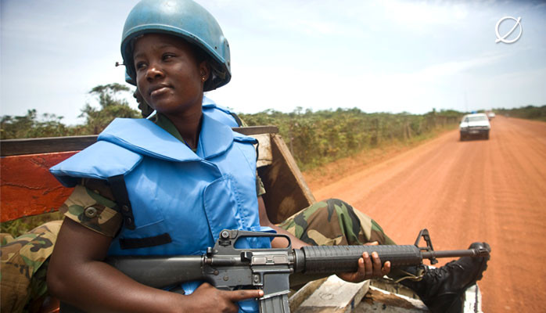
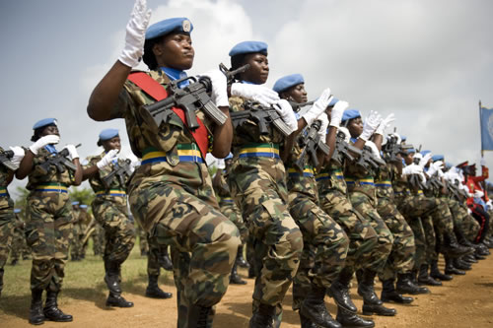
Female Military Peacekeepers

Slide 25
Policing Challenges in Peace Operations
Inadequate numbers in Africa to support operations
  shortfall of experience police personnel
  Low strength at national levels
Lack of common interpretation of laws
  Lack of joint training
  Absence of standard operating procedures
Recruitment of individual Police personnel for missions instead of Formed Units
Poor skills of Africa Police personnel for rule of law, prosecuting and some expertise
Absence of a Police Commissioner/Adviser at the Africa Union

Slide 26
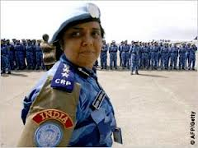
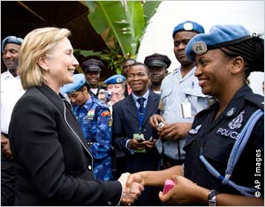
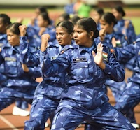
Police Peacekeepers

Slide 27
Other Challenges to Peace Operations in Africa
Partnership between UN and the Africa Union in peace operations lack coordination – Hybrid operations in Darfur, Liberia, Somalia, Mali
Ineffective Africa Union organization for Peace Operations
Introduction of Wet Lease System

Slide 28
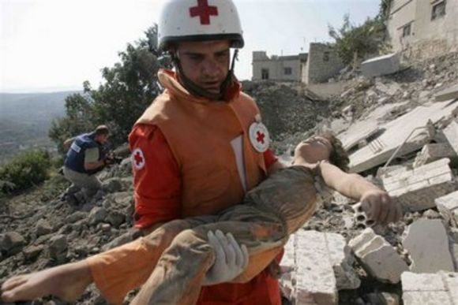
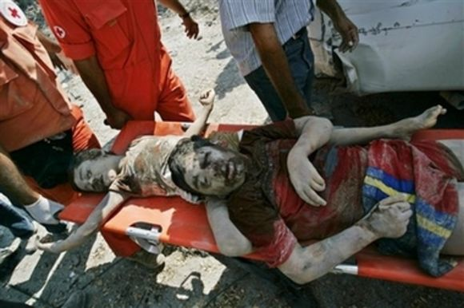
Effects of
War and Conflicts

Slide 29
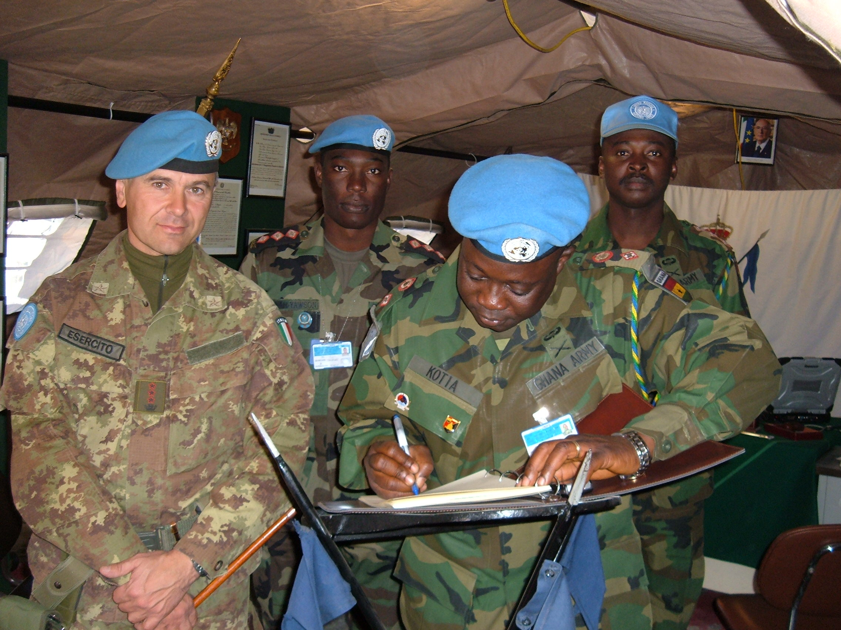


Peace Operations
Liaison Visits

Slide 30

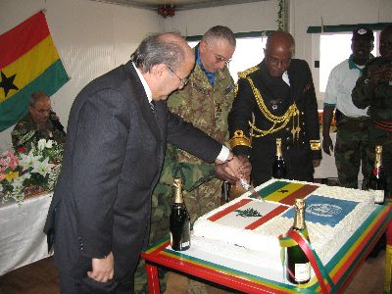
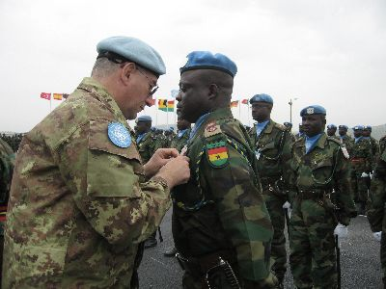
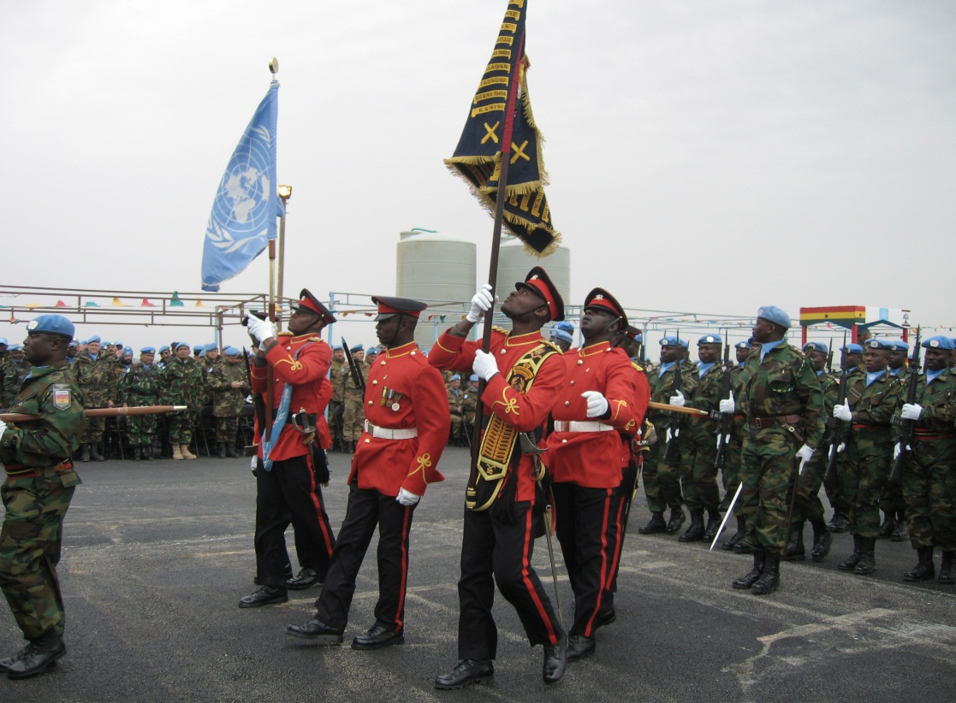
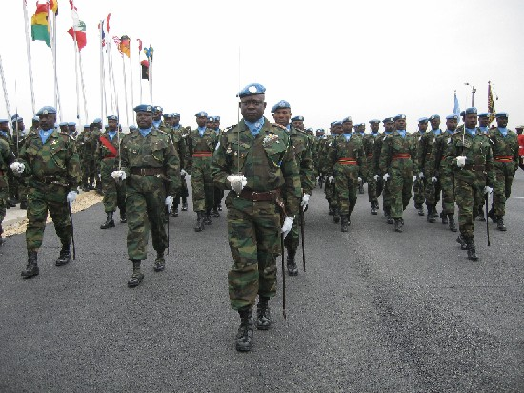
Pictures of Peace Operations
Medal Day

Slide 31
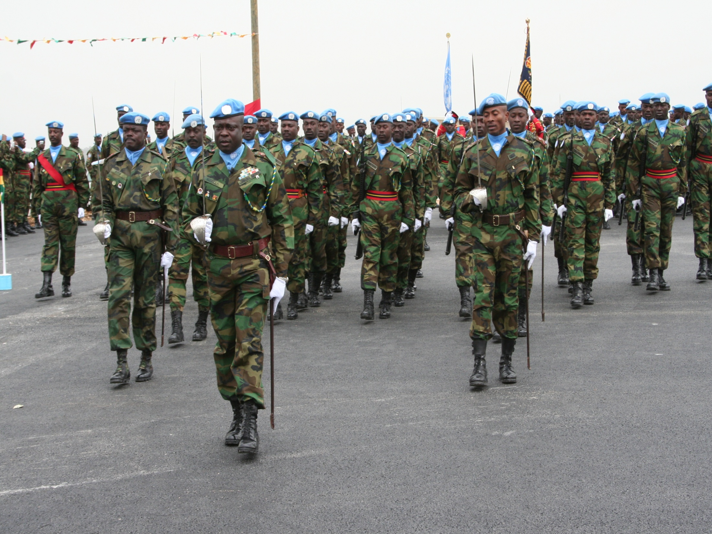
Conclusion
Challenges of Peace Operations in Africa
@EW Kotia

Slide 32
References
Alex Bellamy and Paul Williams, (2010) Understanding Peacekeeping, Second Edition, (Cambridge, Polity Press)
Kotia, Emmanuel W.(2013) "Understanding the Geopolitics of the War in Southern Lebanon." KAIPTC Occasional Paper No. 35. (Accra, Ghana: Kofi Annan International Peacekeeping Training Centre).
Williams Paul., (2011), War and Conflict in Africa, (Cambridge, Polity Press).
Kofi Annan, (2012), Interventions, (New York, The Penguin Press)
Kwesi Aning & Festus Aubyn., (2013) ‘Ghana in Alex Bellamy & Paul Williams, Eds., Providing Peacekeepers: The Politics Challenges and Future of United Nations Contributions (Oxford: OUP)
UN Website on Peacekeeping Operations (www.un.org)
Fortna, V.P. (2008a) ‘Peacekeeping and Democratization’, in A.K. Jarstad and T.D. Sisk (eds), From War to Democracy (Cambridge: Cambridge University Press)
Fortna, V.P. (2008b) Does peacekeeping Work? Shaping Belligerents’ Choices after Civil War (Princeton, NJ: Princeton University Press
Human Security Centre (2005) Human Security Report 2005, (Oxford, Oxford University Press
Mack, A. (2007) Global Political Violence: Explaining the Post Cold War Decline (Coping with Crisis Working Paper, New York: International Peace Academy)
Emmanuel Wekem Kotia. 2012. "Liberia: History of the Origins of War and Profiles of Actors" The Selected Works of Emmanuel Wekem Kotia
Available at: http://works.bepress.com/emmanuel_kotia/2

