Slide 1
Emerging Security Issues
Emerging Threats to National Security and
Development in Africa by
Colonel (Dr) Emmanuel Kotia
Visiting Professor, Kennesaw State University, USA

Slide 2
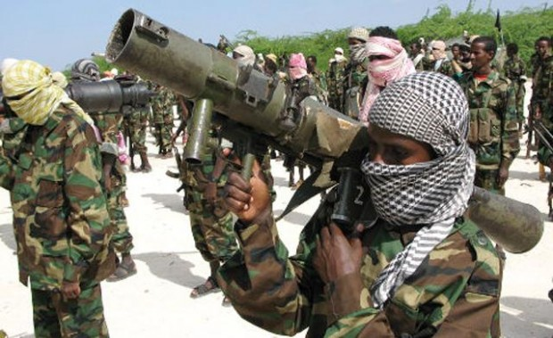
Introduction

Slide 3
Introduction
It is increasingly recognized that there exist a relationship between security and development
Security influences a country’s developmental process. Insecurity disrupts countries and prevents the achievement of development programmes
Development provides well-being to population. A country that experiences no economic and social development cannot claim welfare
The three factors are interrelated, which means, ensuring national security in order to support the development process that leads to social well-being

Slide 4
Aims and Objectives
Brief definition of national security, measures used to achieve national security; and who constitutes the security services in the African context
To highlight emerging security threats to nation-states of Africa
Discuss the causes of insecurity in Africa and strategies of addressing security the threats
Illustrate the role of diplomacy in resolving security threats in Africa
Concluding thoughts

Slide 5
What is National Security?
The concept of national security is considered in its broadest sense and concerns State security, which means, security of persons, institutions, properties and national territory
National security should also include other areas, such as, human security, social security, environmental, etc.

Slide 6
Measures used to Achieve National Security
The use of diplomacy to rally allies and isolate threats
Marshalling economic power to facilitate or compel cooperation
Maintaining an effective armed forces
Implementing civil defense and emergency preparedness measures (including anti-terrorism legislation, national disaster law)
Ensuring the resilience and redundancy of critical infrastructure
Using intelligence services to detect and defeat or avoid threats and espionage, and to protect classified information
Using counterintelligence services or the police to protect the nation from internal threats

Slide 7
Elements of National Security
Military Security -implies the capability of a nation to defend itself, and/or deter military aggression
Political Security -is about the stability of the social order and specifically addresses threats to sovereignty
Economic Security - the freedom to follow choice of policies to develop a nation's economy in the manner desired, forms the essence of economic security
Environmental Security - deals with environmental issues which threaten the national security of a nation in any manner
Security of Energy and Natural Resources -Resources include water, sources of energy, land, oil and minerals

Slide 8
Who Constitutes Security Services?
All departments and state agencies whose primary mission is to provide protection or security to the nation
Security services include the armed forces, gendarmerie, police, intelligence services, border guard, customs, civil defense, fire services, emergency medical services, etc
There are other similar services which are private or established by Diplomatic Representations and International Organizations, such as, the UN
All these services help in protecting countries and security of people and the process of economic and social development

Slide 9

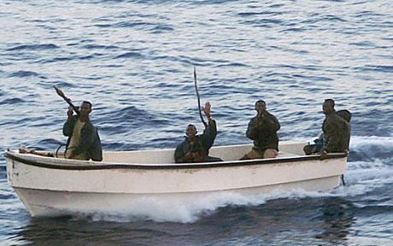

Security Threats to Nation-States

Slide 10
Security Threats to Nation-States in Africa
International and Internal Terrorism – Sahel, Kenya, Somalia, Nigeria, Iraq
Natural and Human-Made Disasters – accidents, floods, earthquakes, tsunamis, volcanoes, etc
Organized Crime – Fraud, Drugs, Money Laundering, Piracy, Hostage Taking, Human Trafficking, Smuggling, Banditry, Armed Robbery
Protest Movements and Rebellions
Cyber crime or Cyber security threats
Ethnic, Land, Chieftaincy and Religious disputes
Emergence of new insecurity stakeholders – Land Guards without training and without knowledge to rights and provisions to war

Slide 11
Security Threats of Nation-States in Africa
Globalization
New facilities of transport, free movement of goods and people, sciences and technology progress, particularly ICT, have influenced the world life
These facilities have allowed and still allow terrorism and crime to spread in the world. Because of Globalization, these threats also become international
Threats affecting Asia countries/Latin America are also felt in Africa. Trafficking of illicit goods, terrorism, money laundering are often favored by Globalization ease
In this context, Globalization is an asset for humanity, but also a source of threats to national and international security.
These threats are a handicap for Africa’s development. Governments have to deal with insecurity, financial difficulties and also the populations’ demands

Slide 12
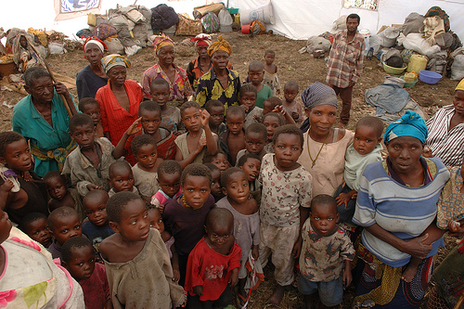
Human Security
@EW Kotia

Slide 13
Causes of Insecurity in Africa
States Weakness and Fragility -When a state finds it difficult to exert its authority throughout the national territory, to control all the country’s activities, or to meet the needs of its population, surely this State is vulnerable to multiples cases of insecurity.
Dictatorial Regime - A country whose Governmental system is dictatorial or totalitarian deprives its population from their rights and prevents freedom of expression. This condition causes frustration, discontent and revolt.

Slide 14
Causes of Insecurity in Africa
Injustice, Exclusion, Discrimination and Corruption A State engaged in such practices causes disorders and secession, rebellion and coup d’état attempts. These are countries where the population does not trust its leaders.
Political instability - A country which lives in political instability is an insecure country. These countries attract criminals, terrorists and all those taking advantage of disorder. Political instability, as the State weakness, does not enable a country’s institutions to function normally and this causes disorder and leads to underdevelopment.

Slide 15
Causes of Insecurity in Africa
Economic and Financial Difficulties. A country whose economy is bad will struggle to confront the population’s discontent. Economic difficulties may be felt in commodities scarcity and rising prices.
Rivalries between Ethnic Groups, different Religious Beliefs and Ideologies. The various entities of the same country could be a valuable resource and an asset, but also, sometimes, a threat of instability
Elections Related Violence. Pre-Elections, During Elections, Post-Elections eg Kenya, Ivory Coast

Slide 16
Addressing Emerging Security Threats
Strengthening good governance – efficiency of Institutions, transparency, accountability, inclusion & participation
Democratization - ensures freedom, respect for human rights, dignity, creativity, trust & mutual respect
Improving Living Conditions of Populations – human & social security of people, creating jobs, infrastructure, promoting business (population feels secured)
Economic Development –
  Economic growth enables Governments to implement programs and projects
  Economic activities make countries able to meet social needs of the population.

Slide 17
Addressing Emerging Security Threats
Capacity Building of National Security Services
  Security Services are at the forefront of security process
  Their role is vital in securing the country
  They ensure security of territory, Institutions, Population & goods
  They need sustainable training and improvement of new security approaches & strategies
  They should be well equipped for the responsibility of protection, monitoring, security & development
Review of security services’ missions and strategies
  Missions respond to country needs – constant reviews of Policies/Frameworks
  Missions will determine strategies & approaches to be followed for security services to adapt to new threats of states

Slide 18
Addressing Emerging Security Threats
Reinforcement of Intelligence Services – ensure monitoring, detection, follow up & gathering information/ coordination of intelligence agencies is key
Public Awareness and Education
  The fight against insecurity is not limited to government & the security agencies
  Population should join efforts with security services
  Population should participate in peaceful conflict resolution, monitoring of suspected cases and vigilance in communities
  Awareness should focus on dialogue, cooperation, & mutual trust between the security services and the population

Slide 19
Addressing Emerging Security Threats
Collaboration Between Security Services of Public Sector, Private Sector, Diplomatic Representations and International Organizations
  Today’s threats do not often distinguish targets, and any sector could be victim of crime or terrorism
  Dialogue mechanisms, collaboration and information sharing are needed to coordinate actions and produce national interest results

Slide 20
Addressing Emerging Security Threats
Strengthening collaboration between different Departments of National Security at International Level
  In a globalized world, a country is no longer capable of ensuring its security alone, regardless of its possibilities
  Security now becomes interdependent
  A close co-operation in capacity building and exchange of knowledge and information is a necessity

Slide 21
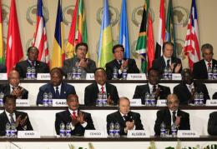
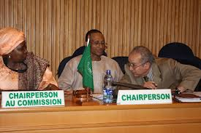
Role of Diplomacy in Resolving Emerging Security Threats in Africa

Slide 22
Role of Diplomacy in Confronting Threats
Conflict Prevention Mechanisms – internal and external
  Preventive diplomacy – conflict close to violence
  Identify key issues, clear mistrust & misperceptions
Assistance in strengthening governance and democracy
Promote economic development
Use of diplomatic structures for continuous peace talks
Embassies empowered to mediate

Slide 23
Diplomatic Strategies
Use of diplomatic structures for peace talks or negotiations
Use of diplomatic strategies that will keep the momentum of peace talks
Diplomatic framework for peace and security
Multi-lateral and Bi-lateral mediation and negotiations with parties
Use of existing diplomatic structures for mediation
Engagement of intractable conflict toward negotiated settlement

Slide 24
Challenges to Diplomacy in Africa
Lack of an efficient regional and organizational structure
Inefficient early warning mechanisms for diplomats – intelligence
Non-existence of a strong diplomatic leadership for mediation (must be gender balanced)
Foreign policy objectives of countries are unclear of the role of diplomacy in resolving conflicts
Existence and the role of external security actors
Poor coordination and non cooperation of the intelligence community in Africa
Funding

Slide 25
Improving Diplomacy in Africa
Clear cut and unified foreign policy for diplomacy in resolving security threats
Coordination and cooperation of diplomatic intelligence efforts
Embassies should be empowered to make cases to governments for greater attention and capacity
Prioritization of intervention strategies
Adequate coverage of potential hot spots (feasibility)
Cooperation between national, regional and external security actors

Slide 26
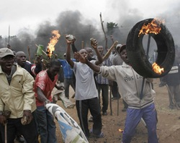
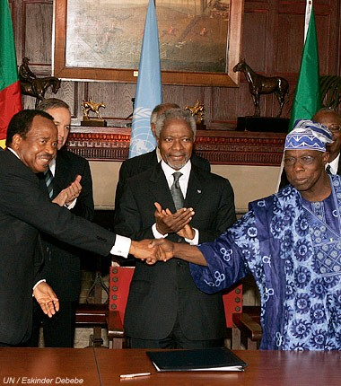
Conclusion

Slide 27
Conclusion
Emerging Security Threats to nation-states of Africa has become a source of problem for most governments in the continent. Internal terrorism especially is increasing rapidly
The causes of insecurity has undermined development and the progress of most African countries. Election-related insecurity is becoming dominant.
Strategies to address security threats in Africa must be harmonized and tackled with seriousness diplomatically. Without this, development will be affected seriously in most countries in Africa

Slide 28
References
The Governance of National Security: Challenges and Prospects (Africa Training and Research Centre in Administration and Development)
Kwesi Aning. 2012 ‘West Africa’s security dilemmas: state fragility, Narco-terrorism and oil politics’ in Africa South of the Sahara (London: Routledge)
Kwesi Aning. 2011 Security links between trafficking and terrorism in the Sahel’ Africa South of the Sahara (London: Routledge)
Williams, Paul., War and Conflict in Africa (Cambridge, Polity Press, 2011)

